Slide 1
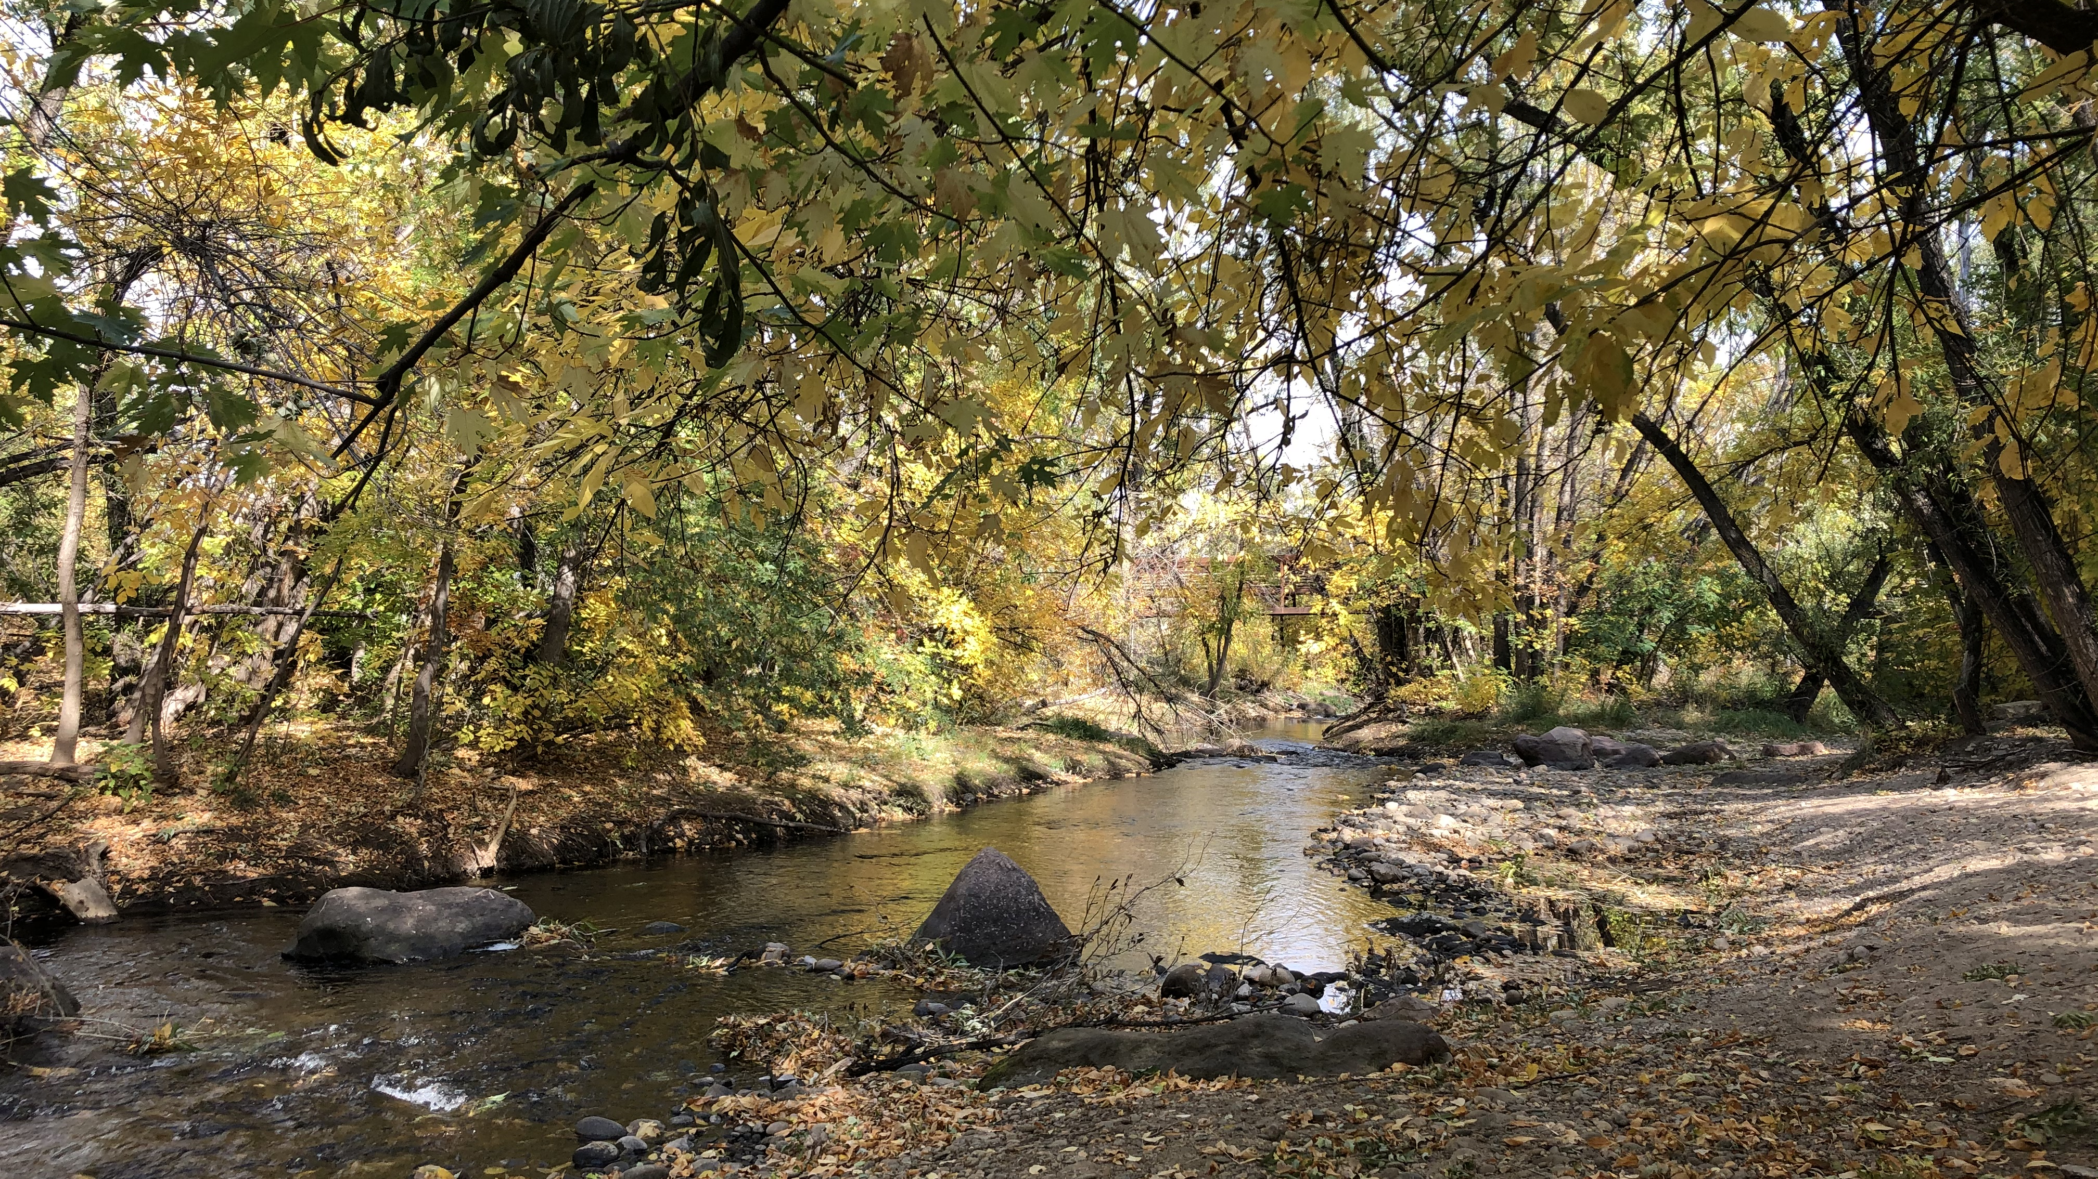
Grouping and aggregating
Analyzing Boulder Creek streamflow data
Link to presentation: https://tinyurl.com/kmx86svn
Link to all lesson materials: https://github.com/eculler/grouping-and-aggregating/

Slide 2
Learning goals – at the end of this lesson, you should be able to…
analyze streamflow data from multiple locations
identify when data analysis will require grouping and aggregating
group and aggregate data in Python with pandas

Slide 3
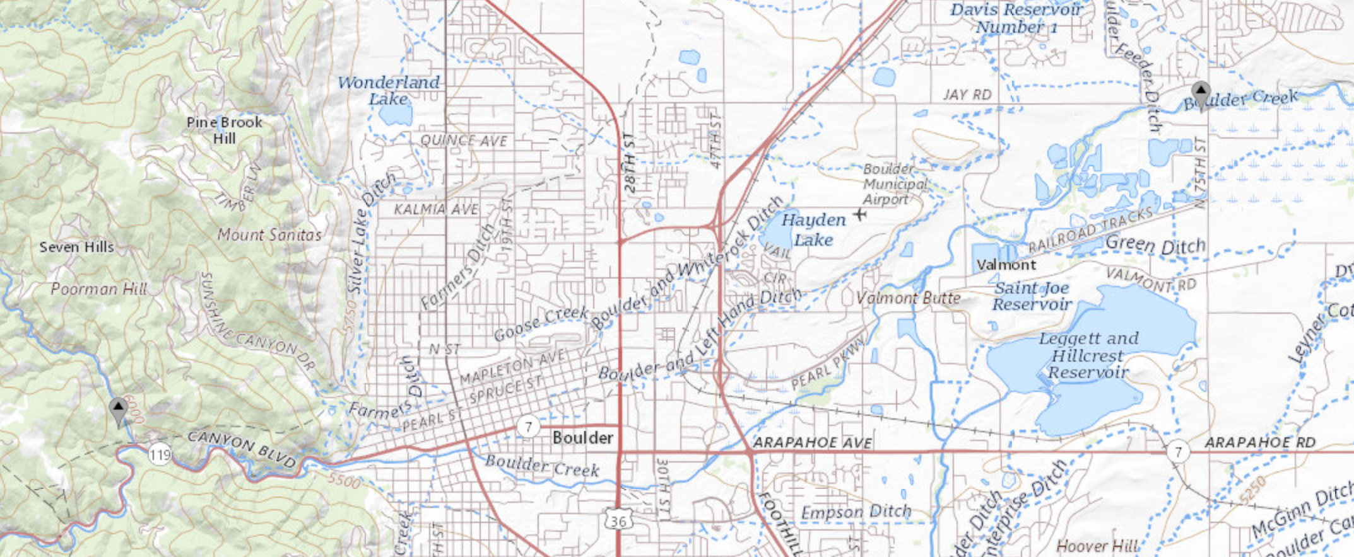
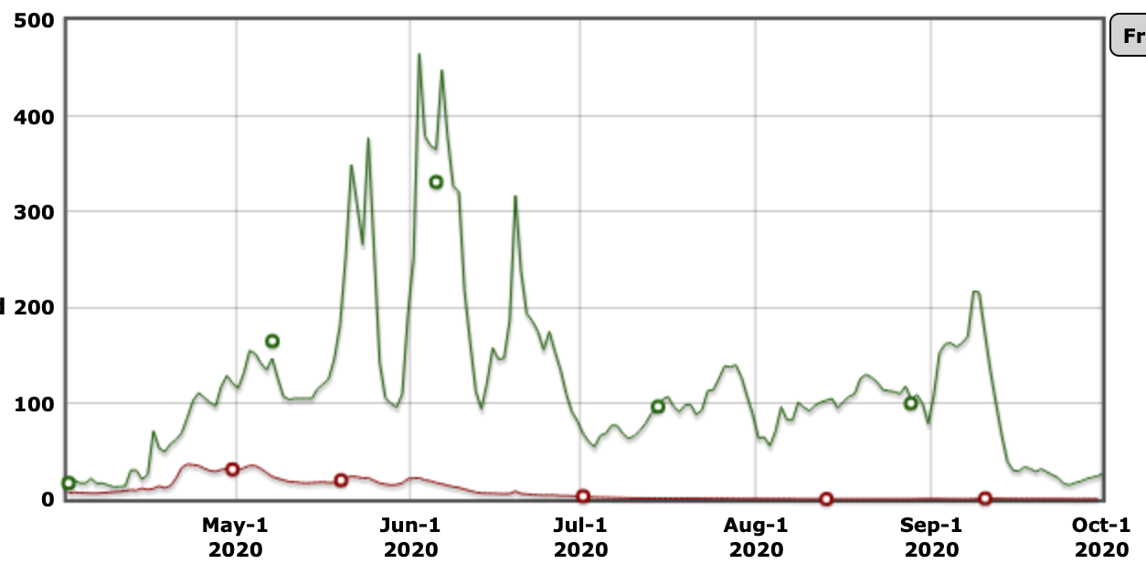
Example data: Ten years of streamflow data from two gauges on Boulder Creek
Downstream
gauge
Upstream
gauge
Streamflow can be very different at an upstream location compared to a downstream location on the same stream
Downstream
gauge
One year of data
Daily discharge (cfs)
Upstream
gauge
Notes:
Pair and share

Slide 4
How much of the total streamflow at the downstream gauge comes from the upstream gauge’s branch, on average?
Notes:
Pick one of these questions. What steps would you need to take to calculate the answer?

Slide 5
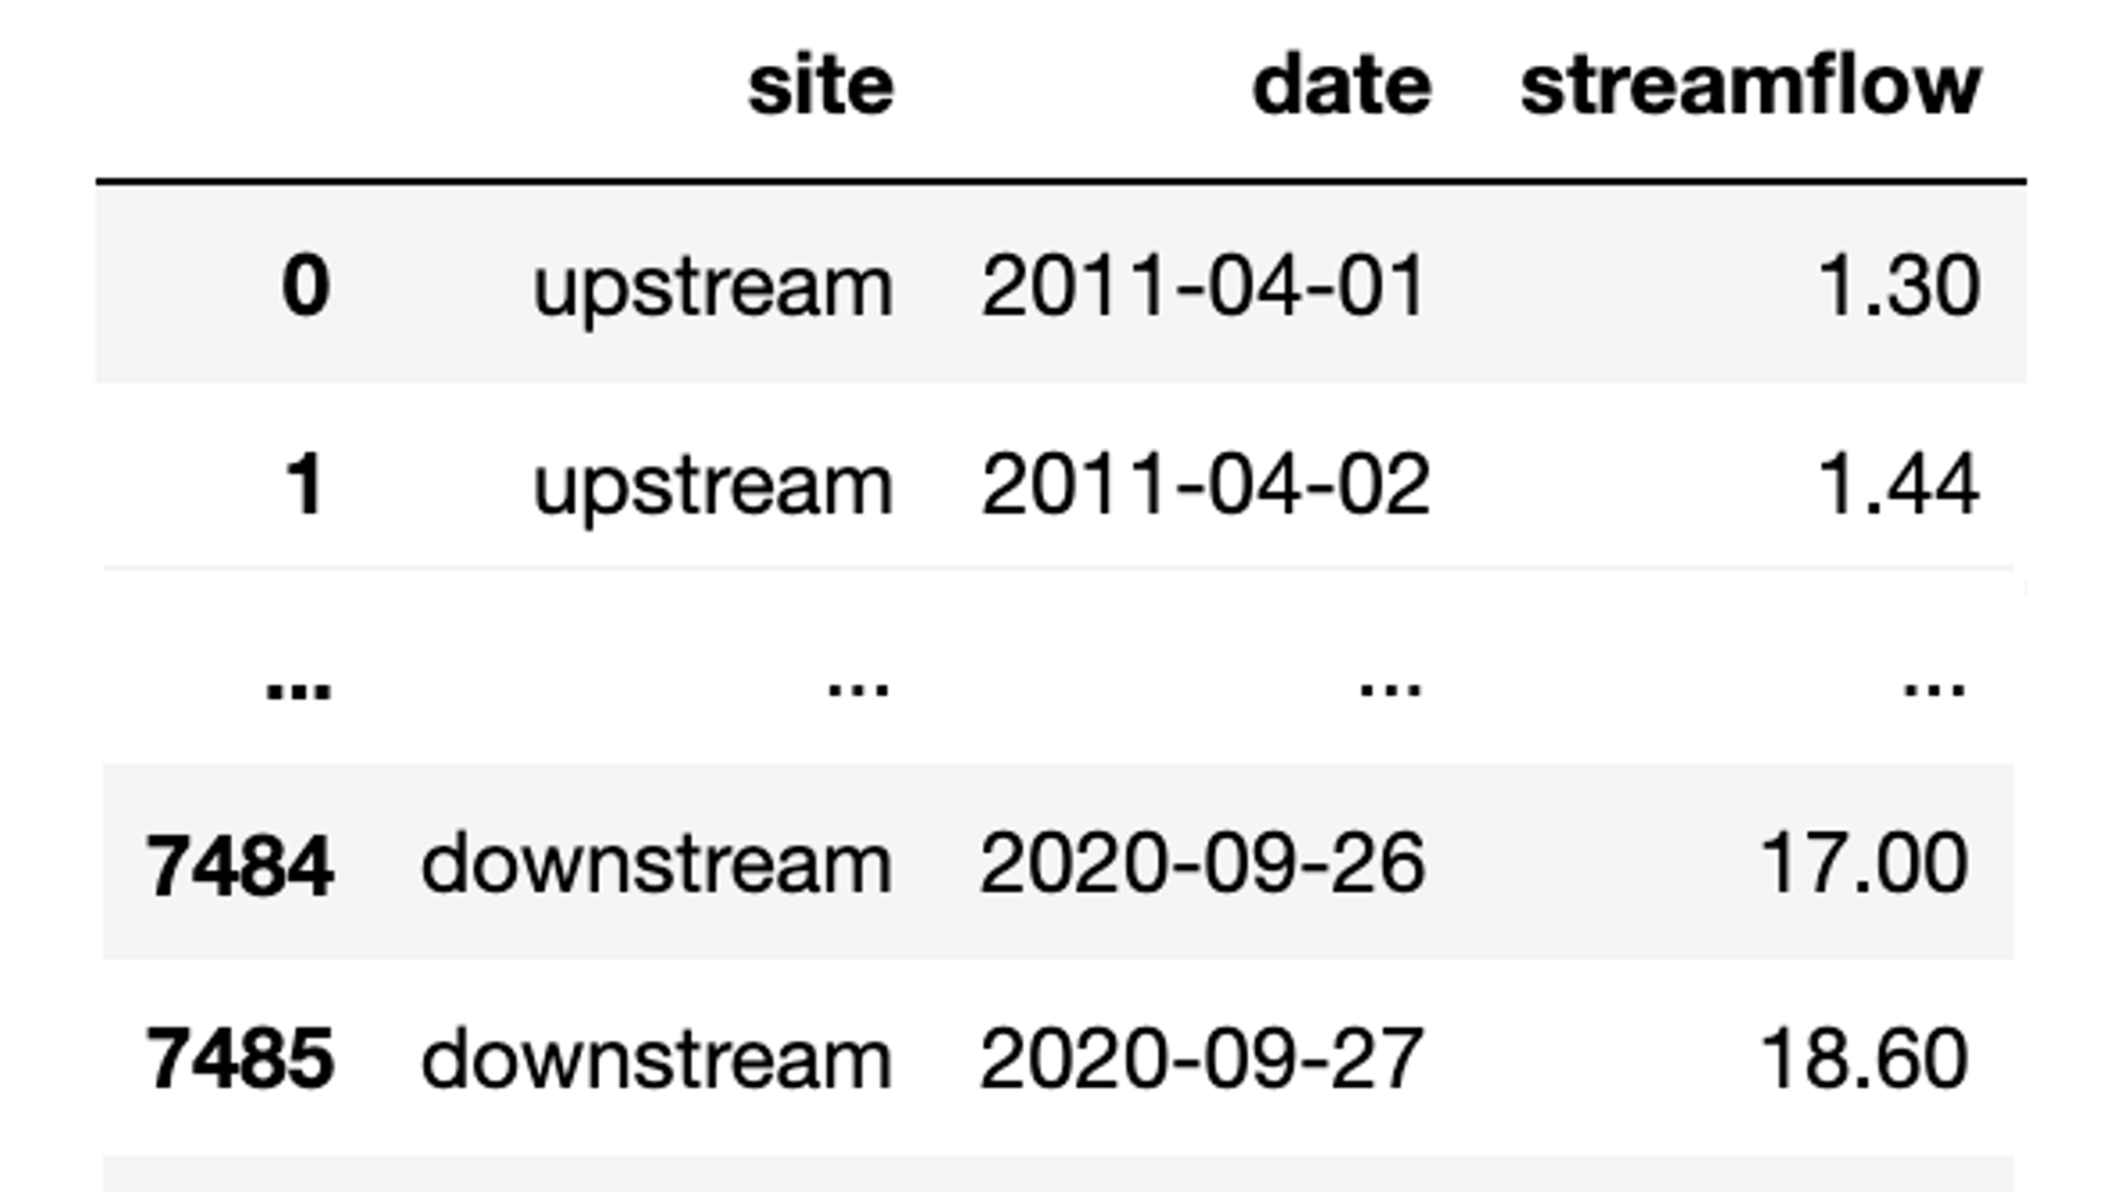
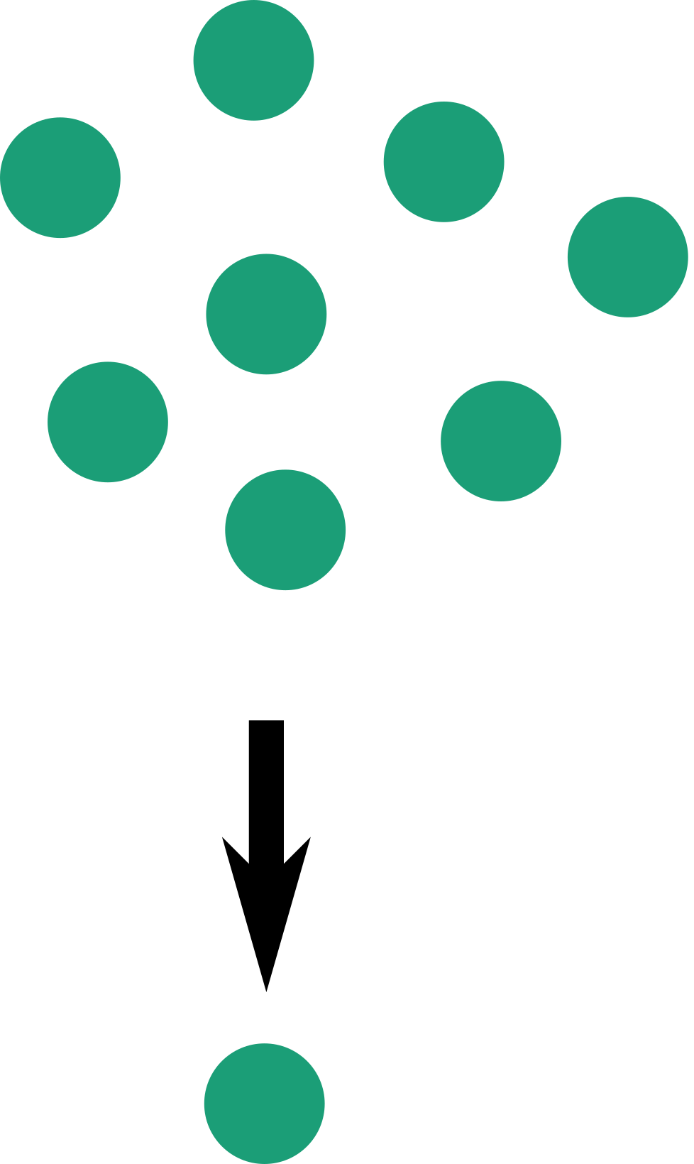
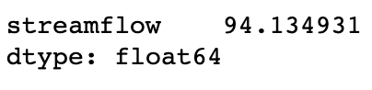
A function that aggregates data takes many data points and returns a single number that describes them all.
Examples include average, minimum, maximum, median, count
dataframe
dataframe.agg(‘mean’)

Slide 6
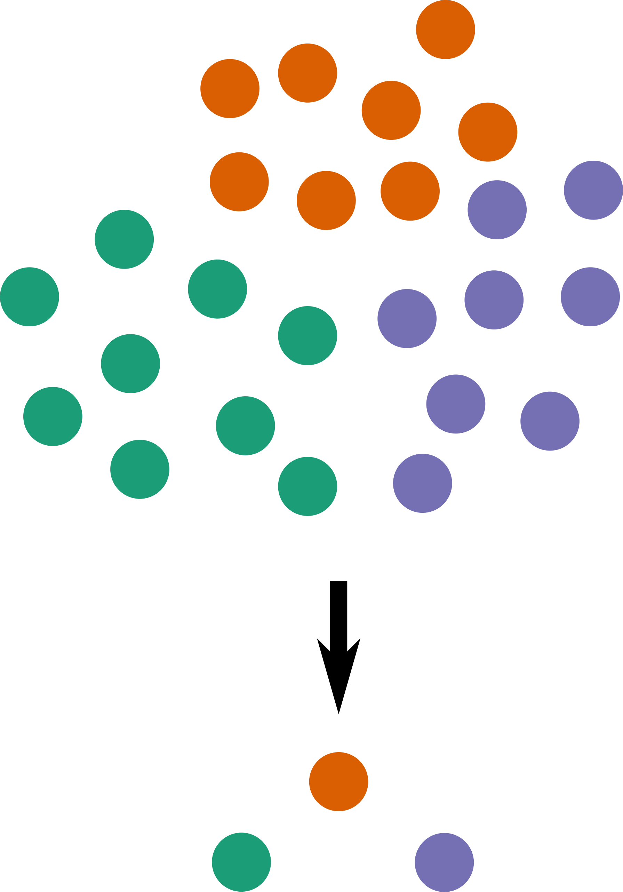
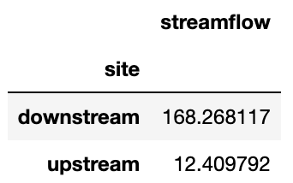
Aggregating functions can be used to compare groups of data with different properties
For example, data could be grouped by date, location, cluster, or event
dataframe
dataframe.groupby(‘site’)
dataframe.groupby(‘site’
).agg(‘mean’)
pandas.core.groupby.generic.DataFrameGroupBy object

Slide 7
Grouping and aggregating using Python and pandas
pandas.DataFrame.groupby(by)
Set the variable(s) you want to use to group the data.
Does not change the data
pandas.DataFrame.agg(func)
Applies func (a function or list of functions) to return one row for each group
Special aggregating functions like mean(), max(), and min() are also available

Slide 8
Let’s try it!
https://tinyurl.com/544j5c4a

Slide 9
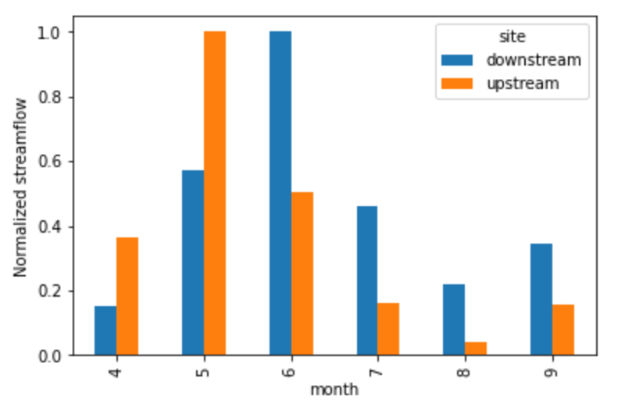
Extended application of grouping: monthly and seasonal aggregation
Is the pattern of monthly streamflow the same or different for each of these gauge locations?
Notes:
Pick one of these questions. What steps would you need to take to calculate the answer?

Slide 10
Extended application of grouping: Analysis of variance
Which of the gauges has the most relative variability in monthly and daily streamflow?
Notes:
Pick one of these questions. What steps would you need to take to calculate the answer?

